Slide 1
Video 4: Example
Maria Leedham
Full resource: https://www.ncrm.ac.uk/resources/online/all/?id=20855

Slide 2
EXAMPLE CADS PROJECT C: Female and male authors of Young Adult fiction

Slide 3
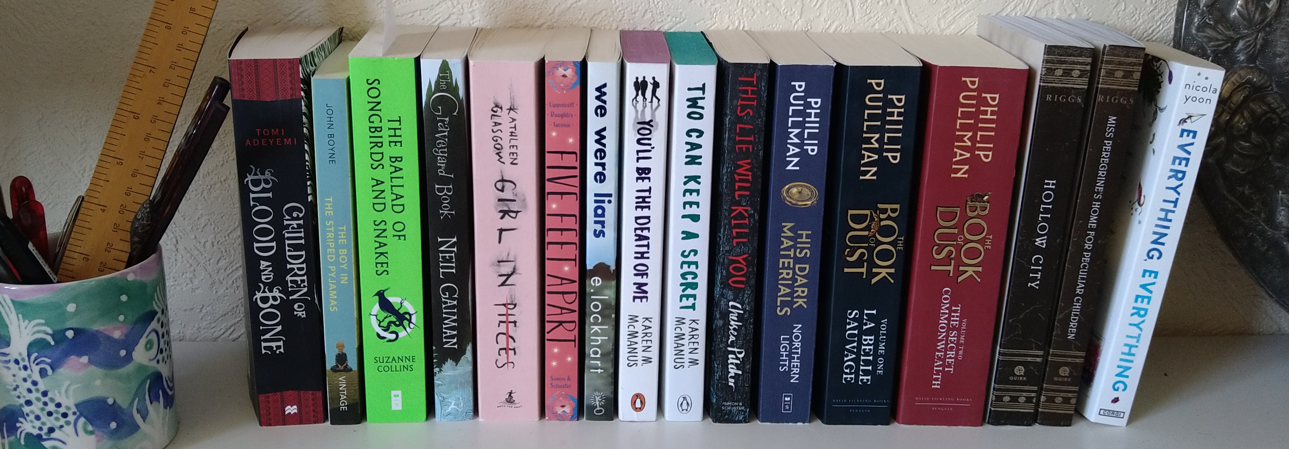
Female and male authors of Young Adult fiction
Aim: To compare Young Adult fiction writing by female and male authors
RQs
1. What differences and overlaps exist in the fictional worlds created by female and male authors?
2. What can the responses of secondary school students and their school librarians to our findings add to our analysis?

Slide 4
Key semantic domains
 | DoRA_F |  |  | DoRA_M
Rank | Domain | Example lexis |  | Domain | Example lexis
1 | Unimportant | regardless. minor, meaningless |  | People: male | man, boy, bod, men, boys, guy, guys
2 | Tough/strong | stronger |  | Sailing, swimming, etc | boat, canoe, boats, paddle, ship
3 | Deserving | deserved, deserve |  | Geographical terms | river, hill, island, sea, swamp, earth
4 | Evaluation: good/bad | grade, appraised |  | The universe | world, sky, moon, starts, universe, sun
5 | The media | media, coverage |  | Substances and materials: liquid | water, wet, oil, damp, drop, dripping
6 | Impolite | offended, rude |  | Time: old, grown up | old, adults, adult, grown up, grow up, grew up
7 | Emotional actions, states & processes | tone, mood, emotion, feel |  | Farming and horticulture | field, farm, fields, farmers, farmer, planted
8 | Discontent | disappointed, disappointment, frustrating |  | Warfare, defence and the army; weapons | shot, gun, army, soldiers, war, rifle
9 | Confident | mind, confident, confidence |  | Drinks and alcohol | bar, drink, coffee, tea, bars
10 | Attentive | attention, focused, focus |  | The media: Books | book, books, chapter, library, hero, novel
Notes:
Table x F authors with M authors as RC on the left, and M authors with F authors as RC on right
Wmatrix
LL 12
min freq. 50
sorted on effect size
excluded categories dominated by proper names or miscategorised

Slide 5
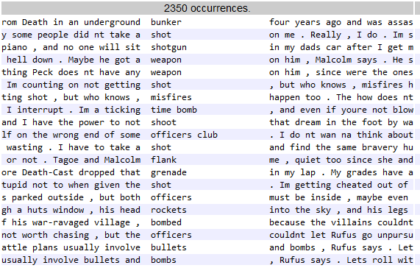
Semantic domain of warfare
Notes:
Exploring Warfare, defence and the army; weapons
Some of these are metaphorical usage:-
Take a shot on me
I’m a ticking time bomb
Shoot that dream in the foot

Slide 6
Student responses to Q: Does it surprise you that female and male authors write about different things?
B12: I mean I'm I'm sure it is fine cause I don't think anyone’s reading and realising this it could be a subconscious kind of intake of, and it might be that people prefer emotional stories and just gravitate towards female in general and then may create a like their own personal bias towards you know. [...]
B12: I don't think I'd really even even if I did notice the pattern, I wouldn't necessarily ascribed to the gender of the author as much as I would ‘Ohh, this is just a world like a more world, this is just a more personal character story and that's less I think I would view it as less than even though it is something I wouldn’t thought of that really.
G81 I think might have have to do with the fact that people usually think that men are supposed to, like, uphold the houses, like everything in order and
G82 be stronger.
G81 and be stronger, yeah. So they tend not to show their emotions more because, like, it's just how it is. People just assumed that men are the strong ones and they didn’t show their emotions and women just the housewives just go round cleaning up things, that being emotional and teaching the children how to be
8AS I think it doesn't, it’s not really about that. It's kind of like the thought that counts. The thought that they tried to make that, it’s kind of like the thought that counts that they try to make their characters diversified. It's not really how it’ll end up being cause in the end we've all got something influencing us. We're all been indoctrinated in some kind of way and there's no way of us knowing

Slide 7
References
Gee, J.P. (2010). An Introduction to Discourse Analysis: Theory and Method (3rd ed.). Routledge. https://doi.org/10.4324/9780203847886
http://www.writinginsocialwork.com/our-project/
Leedham, M. (2015). Chinese Students' Writing in English: Implications from a Corpus-Driven Study. Abingdon, UK: Routledge, 184pp, ISBN 978-0-415-85854-0.
Leedham, M.; Hunt, S. and Mukherjee, S.J. (2024). ‘Gendered characters and gendered worlds in best-selling, contemporary Young Adult fiction’. In: Corpus-Assisted Discourse Studies conference, 17-19 July, 2024, Innsbruck, Austria.
Leedham, M. ‘Social Workers Failed to Heed Warnings’: A Text-Based Study of How a Profession is Portrayed in UK Newspapers, The British Journal of Social Work, Volume 52, Issue 2, March 2022, Pages 1110–1128, https://doi.org/10.1093/bjsw/bcab096
Sinclair, J. (Ed.) (1991). Corpus, Concordance, Collocation. Oxford, UK: Oxford University Press.

Slide 8
www.ncrm.ac.uk

